Slide 1
1
Opportunity Analytics: End-to-End Data Visualization & Strategic Insights
Final Presentation & Internship Reflection Deck | Team 7
Leadership
Team Members
Team Lead: Niranjan Kumar Dasari
Project Manager: Ademola Alaanu
Project Lead: Tumo Matsena
Ritah Munyeti · Madhuri Yanamala · Mounika C · Chinyere Cynthia Okwara · Vanmathi
Data Visualization Trainee Early Remote Internship
August 2022 – May 2026 Dataset Analysis

Slide 2
2
Project Objectives
The primary objectives of this analysis are to:
1
Ensure Data Integrity
Standardize raw operational data, handle nulls/outliers, and ensure analytical readiness across all 5,728 records.
2
Conduct Trend Analysis
Analyze opportunity creation and applicant sign-up trends over time from Q3 2022 through Q2 2026.
3
Evaluate Channel & Delivery
Evaluate distribution of opportunities across virtual vs. remote modalities and opportunity types to understand platform reach.
4
Assess Scholarship Allocation
Measure financial aid distribution, currency reliance, and affordability metrics across the ~$920K scholarship pool.
5
Deliver Actionable Strategy
Deliver data-driven recommendations to drive year-round platform growth and reduce seasonal volatility.

Slide 3
3
Executive Summary
This report presents a Full Lifecycle Analysis of 5,728 cleaned opportunity records. The dataset includes internships, competitions, events, masterclasses, and programs.
The analysis was conducted to assess platform growth, distribution modes, funding models, and seasonal engagement, with the goal of identifying trends and insights to support informed decision-making. An interactive dashboard was developed to consolidate findings and provide clear visualizations of key performance areas.

Slide 4
4
Dataset Architecture & Data Cleaning Methodology
Dataset Overview and Tools Used
The analysis was conducted on a dataset of 5,728 opportunity records from Q3 2022 to Q2 2026
Tools Used: Excel, Power Bi, Python for data cleaning, analysis, and visualization.
ne Dataset
Data Cleaning and Preparation
Before analysis, the raw dataset was cleaned to ensure accuracy and consistency. The Data Preparation and Cleaning Workflow included:
1 malformed record removed
Zero duplicates retained
Whitespace & Case Standardization
Lowercased all schema attributes and normalized categorical values (e.g., standardizing "Work From Home", "Virtual", "On-site").
Handling Missing Data
Standardized missing location attributes as "Unknown" and converted null placeholders into SQL/Python-compliant null values.
Outlier Mitigation
Filtered out realistic entry errors (e.g., listing values exceeding $10M) to maintain robust average calculations.
Date Standardization
Converted all timeline markers into standard YYYY-MM-DD formats for consistent temporal analysis.

Slide 5
5
Key Performance Metrics & Data Overview
5,728
$920K
Total Listings
Scholarship Pool
Analysis-ready opportunity records across the full dataset period.
Total value of financial aid distributed across eligible listings.
$120
78.9%
Median Award
Free Listings
Median scholarship value; mean award stands at $176 per listing.
Share of all opportunities carrying no participation fee.
74.6%
83.7%
Remote Delivery
USD Dominance
Share of specified-mode listings delivered remotely or virtually.
Proportion of total scholarship funding denominated in US dollars.
Dominant Category: Internship — 1,589 listings (27.7% of total platform volume)
Remote Split: 55% Work From Home / 45% Virtual among remote-classified listings

Slide 6
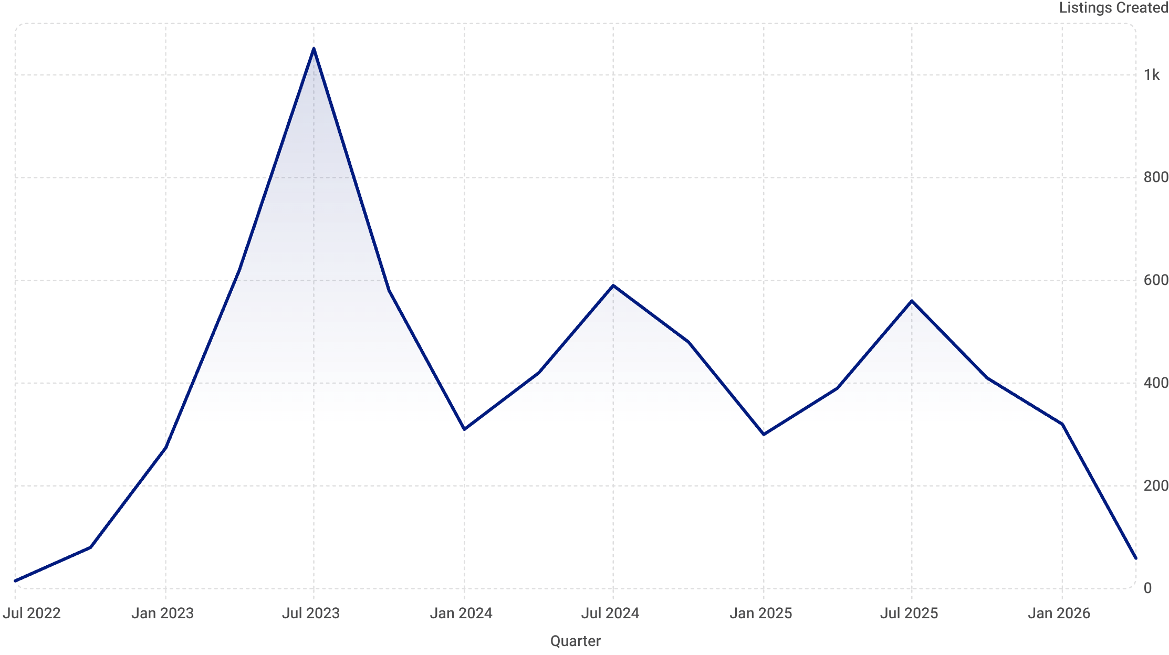

6
Historical Sign-up Trends & Seasonality
PHASE 1
PHASE 2
PHASE 3
Late 2022 — Early 2023
Peak 2023
2024 – 2026 Stabilization
Initial launch with modest volumes: 15 listings in Q3 2022 scaling to 274 by Q1 2023.
Rapid expansion reaching all-time peak in Q3 2023 at 1,051 created listings — a platform record.
Market stabilization averaging 300–600 listings per quarter. Q2 2026 partial quarter reflects 59.
Pronounced Q3 surges are structurally tied to academic calendar transitions, followed by routine lulls in Q1 and Q2 — a pattern requiring targeted off-peak engagement strategies.

Slide 7
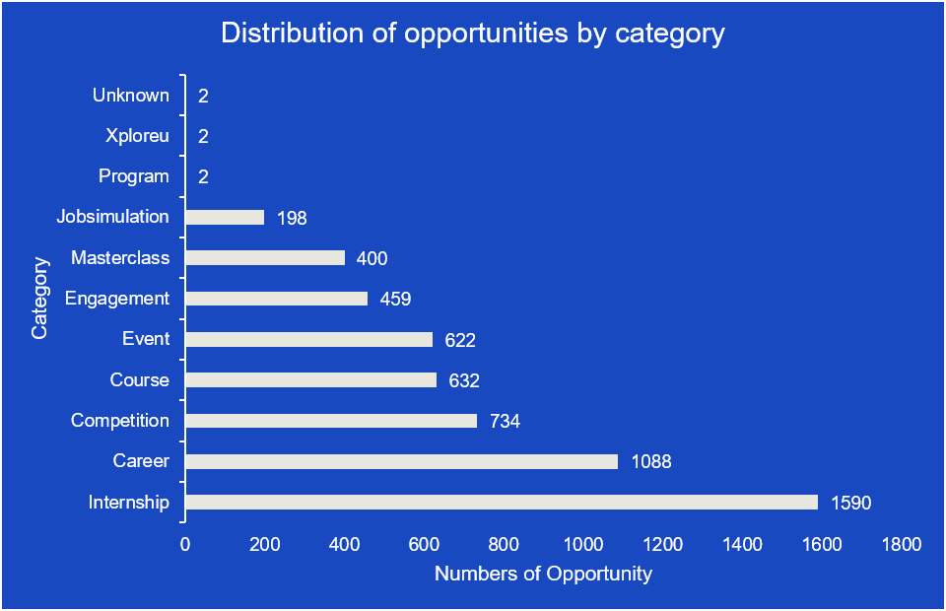
7
Distribution of Opportunities by Category
Key findings
Internship represented the largest share of the opportunities.
Competition and events were also common.
masterclasses and program had fewer opportunities.
Only a small number of records were classified as “unknown”.
Most opportunities in the dataset were internships, indicating a strong emphasis on career development and practical learning experiences.
Pronounced Q3 surges are structurally tied to academic calendar transitions, followed by routine lulls in Q1 and Q2 — a pattern requiring targeted off-peak engagement strategies.

Slide 8
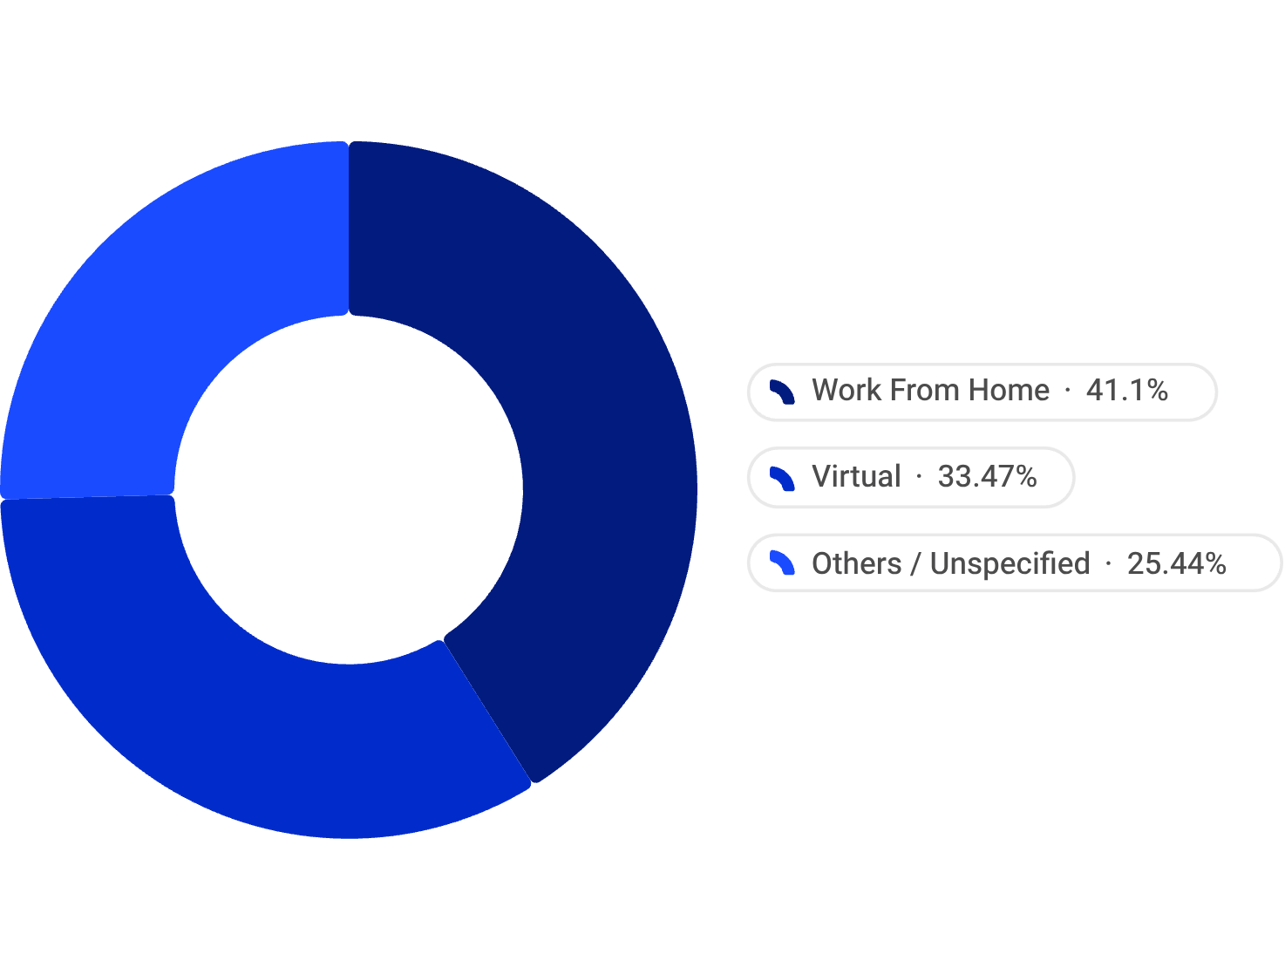
8
Delivery Mode & Opportunity Category Distribution
Modality Breakdown
Category Breakdown
Category
Listings
% Free
Avg Scholarship
Internship
1,589
73.7%
$165
Career Programs
1,088
93.4%
$175
Competitions
733
79.4%
$203
Courses
632
82.8%
—
Events
622
63.0%
—
Competitions yield the highest average scholarship at $203, while Career Programs lead in free-access rate at 93.4%.
Core Insight: Over 75% of classified opportunities utilize remote or location-independent delivery modes, reflecting high demand for geographical flexibility.

Slide 9
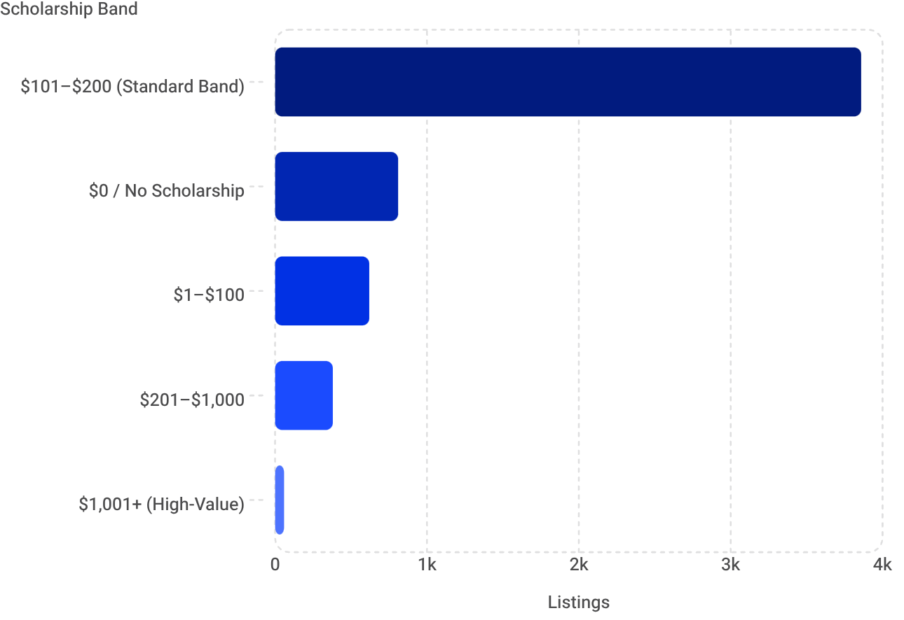
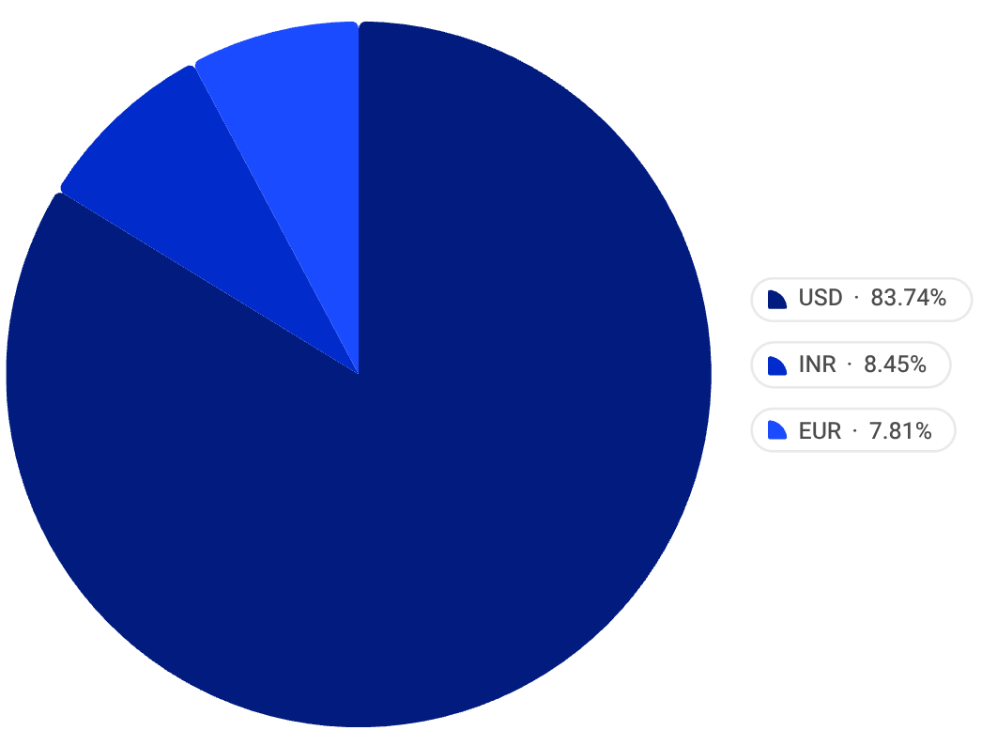

9
Financial Aid & Currency Allocation Insights
Scholarship Value Distribution
Global Currency Breakdown
USD — 83.7% ($837,019)
67.4% of all listings fall into the $101–$200 band, indicating standard corporate/institutional funding limits rather than individualized awards. High-value scholarships ($1,001+) are reserved for top-tier competitions and specialized programs.
Dominant funding currency across the platform.
INR — 8.5% ($84,509)
South Asian regional pool; significantly underfunded relative to demand.
EUR — 7.8% ($78,028)
European market dependent on a comparatively small local currency pool.
Platform funding is heavily dollar-denominated, leaving European and South Asian regional markets dependent on smaller local currency pools — a structural equity gap requiring targeted corporate partnerships.

Slide 10
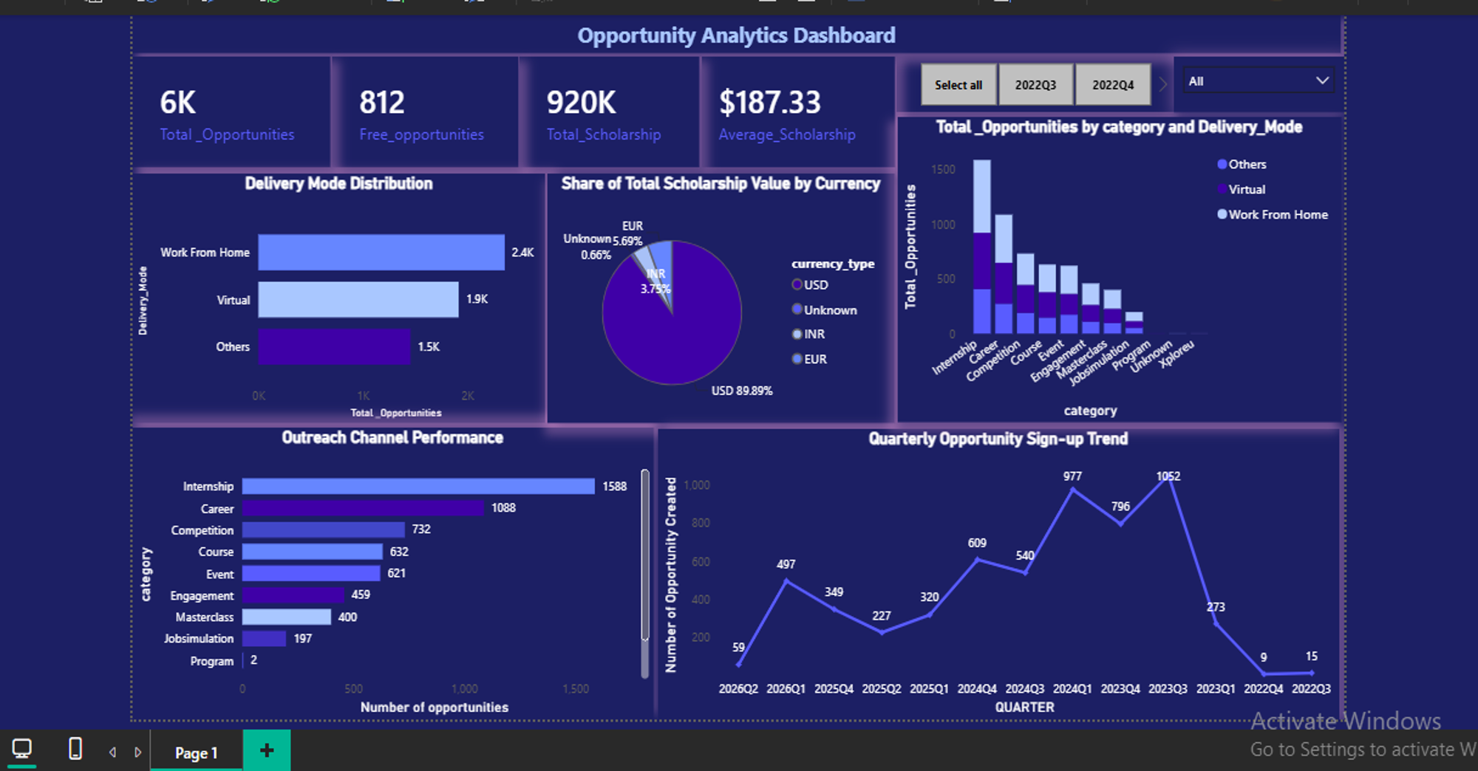
10
Power BI Dashboard

Slide 11
15
Major Insights
A total of 5729 opportunities were analyzed
2024 recorded the highest number of opportunities created
Internships were the most common opportunity category
Most opportunities offered micro scholarship of 120, while some had no scholarship.
Opportunities were concentrated in a few locations and organizations.
Opportunities availability varied over time, showing clear growth and decline patterns.

Slide 12
17
Key Takeaways
Data Cleaning • The dataset has a total listings of 5,728 • Missing values, duplicate records, inconsistent categories, and unnecessary columns were addressed to improve data quality. • The cleaned dataset provided a reliable foundation for accurate analysis and dashboard reporting.
Insights
Internships were the most common opportunity category
Work From Home and Virtual made up the largest share of delivery modes, showing the growing importance of remote opportunities.
In scholarship value distribution, 67.4% listings fall into the 101-200 with USD as the dominant currency
2023 recorded the highest number of sign-ups, indicating the highest level of engagement
Recommendation
Run special campaigns at the first half of the year to encourage early registration
Important fields should be made compulsory for users to complete
Partner with more organizations in Europe and South Asia to promote more scholarships in Euros and Rupees

Slide 13
16
Strategic Recommendations
Action Plan for Growth & Operational Excellence
1
Flatten Seasonal Volatility
Launch targeted Q1/Q2 early-registration drives and Winter/Spring Micro-Internships to eliminate early-year engagement dips and reduce dependence on Q3 surges.
2
Diversify Category Offerings
Expand non-internship categories — mentorships, research grants, skill bootcamps — to reduce reliance on internships (currently 27.7% of all listings) and broaden platform appeal.
3
Strengthen Data Collection Protocols
Enforce mandatory input fields for location, delivery format, and currency details to eliminate missing data and improve future analytical precision.
4
Regionalize Financial Aid Pools
Establish corporate partnerships in Europe and South Asia to scale EUR and INR funding pools beyond their current 8.5% and 7.8% shares of total scholarship value.
5
Optimize Remote Offerings
Prioritize partnerships offering verified Work From Home/Virtual setups to align with the 75%+ user preference for location-independent delivery already evidenced in the data.

Slide 14
18
Conclusion & Internship Reflection
Project Conclusion
Team Reflection & Growth
The Opportunity Analytics project successfully converted complex multi-year data into clear visual insights, proving strong market adoption in flexible remote internships while pinpointing clear operational levers for future growth.
End-to-End Workflow Mastery
Gained hands-on expertise spanning Data Cleaning, Exploratory Data Analysis, SQL/Python standards, Power BI dashboard construction, and executive reporting.
5,728
$920K
Collaborative Success
Records analyzed end-to-end
Scholarship pool mapped
Demonstrated effective team synergy across roles — Lead, PM, Scribe, Analysts — to deliver presentation-ready business intelligence from raw operational data.
4 Years
Q3 2022 – Q2 2026 coverage
Team 7 · Data Visualization Trainee Early Remote Internship
Niranjan Kumar Dasari · Ademola Alaanu · Tumo Matsena · Ritah Munyeti · Madhuri Yanamala · Mounika C · Chinyere Cynthia Okwara · Vanmathi

Slide 15
19
Week 1 – Week 4 Projects
Week 1 Deliverables
https://drive.google.com/file/d/1jjkGyU82bBa6_xHF6K4Yc3uCjUgvOyP-/view?usp=drive_link
Week 2 Deliverables
https://drive.google.com/file/d/1_h5Dj7dsgzCYNnmZUFUmI5vvOHiZTodQ/view?usp=drive_link
Week 3 Deliverables
https://drive.google.com/file/d/1Png1z1DVeZGIA9_cPwTGKfqATwzvdFTA/view?usp=drive_link
Team Presentation Video
https://drive.google.com/file/d/1gGeELwIyVN6-so5Mhawq9UAVP_JlL5Bl/view?usp=drive_link

